Slide 1
WELCOME

Slide 2


Jnana Sangama,Belgaum-591008
Ramanagaram-562159
An Internship Presentation on
“Bottle Filling for Different Measurements”
Carried out at
“TECHNOCLOG LLP”
Presented By
Vishwas V
1GC17EC029
Under the Guidance of
Mr.C.K.VENKATESH
Asst. Professor, Dept. of ECE, GCE,
Ramanagaram-562159

Slide 3
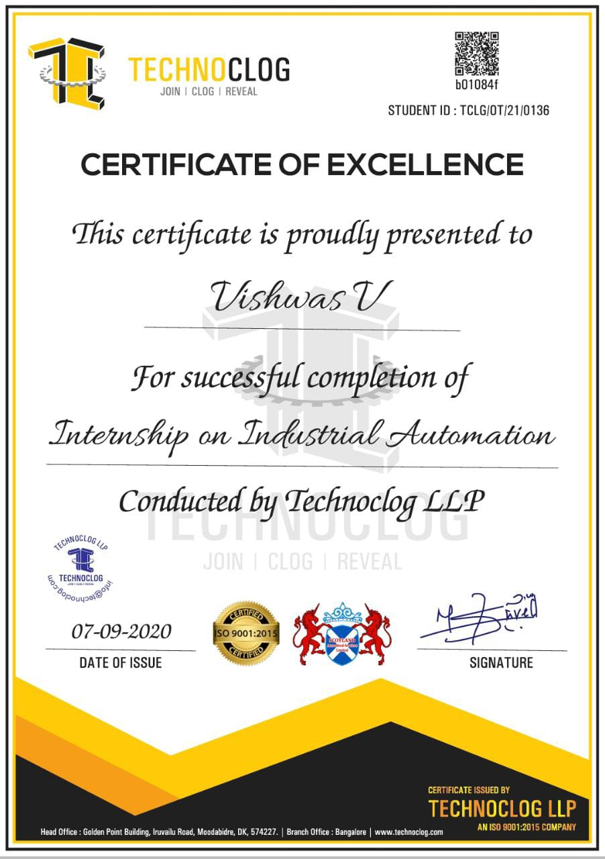
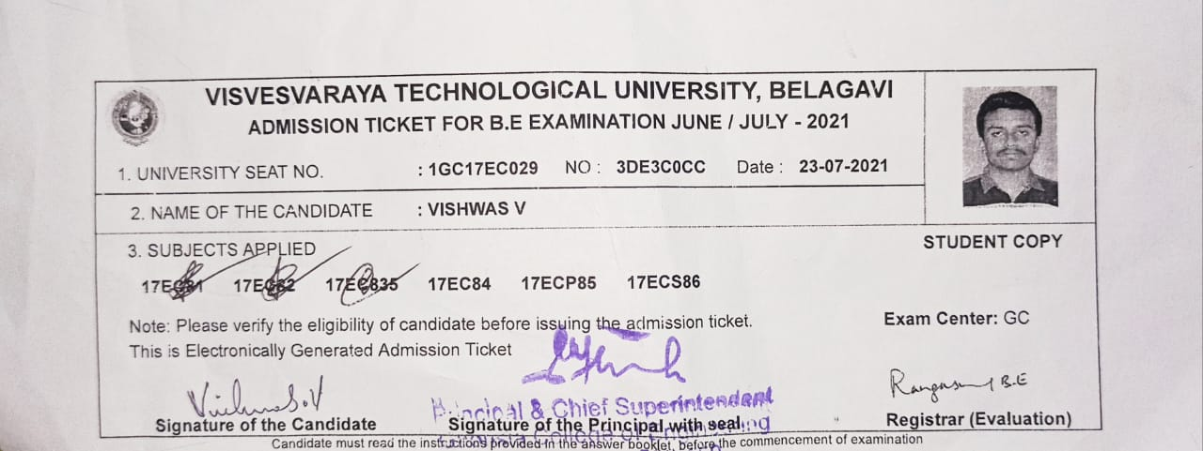
INTERNSHIP CERTIFICATE
ADMISSION TICKET

Slide 4
CONTENTS
About the Company.
About the Department.
Programable Logic Controller.
Supervisory Control And Data Acquisition.
Mini-Project Carried Out At Internship.
References.

Slide 5
About the Company
TECHNOCLOG LLP culminated into one of the leading training institutes in Moodabidri , Dashan Kannada for advanced training. We carry a blend of less theoretical and more practical subjected training.
TECHNOCLOG LLP was started on 1st of August 2018 and registered under Ministry of Micro Small and Medium Enterprise.
On 4th Feb 2021 the company was in corporate under ministry of corporations as Limited Liability Partners Company and approved the name as TECHNOCLOG LLP.
They mainly aim on Agriculture, Home and Industrial Automation, IOT, IIOT, Projects and Training on to Industries and academics.

Slide 6
About the Departments
Production.
Service Organizations.
Research and Development
Purchasing
Human Resource Management
Accounting and Finance.

Slide 7
Programmable Logic Controller
A programmable logic controller, PLC is a digital computer used for automation of typically industrial electromechanical processes, such as control of machinery on factory assembly lines etc., It is a solid state user programmable control system with functions to control logic, sequencing, timing, arithmetic data manipulation and counting capabilities.

Slide 8
Advantages of PLC.
Small physical size, shorter project time.
Ability to communicate with computer systems in the plant.
Ease of maintenance /troubleshooting.
Reduced space
Disadvantages of PLC.
When a problem occurs, hold-up time is indefinite, usually long.
There are limitations of working of PLCs under high temperature, vibration conditions.
some PLCs turns on when power is restored and may cause any accident.
Applications of PLC.
Petrochemical industry
Steel industry
Nuclear power generation plants.

Slide 9
Supervisory Control And Data Acquisition
In the year 1960, the first computer-based supervisory control system came into existence. And that was designed on mainframe computer technology.
SCADA stands for Supervisory Control And Data Acquisition.
It is a purely software package that is positioned on top of hard-ware to which it is interfaced, in general via PLC
SCADA systems are now also penetrating the experimental physics laboratories for the controls of ancillary systems such as cooling, ventilation, power distribution, etc.
Working Procedure of SCADA
The Primary functions of SCADA are performed through a combination of sensors, RTUs, controllers and communication networks.
Data acquisitions
Data communications
Information/data presentation
Monitoring/control

Slide 10
Operations and tasks of SCADA
Controlling field devices
Alarm handling
Limits changing
Operation Modes
Data archiving
Events logging
Production of reports & trend charts
Potential benefits of SCADA
The amount of speciﬁc development that needs to be performed by the end user is limited, especially with suitable engineering
Reliability and robustness.
Technical support and maintenance by the vendor

Slide 11
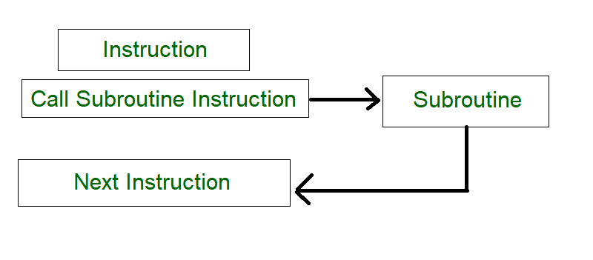
Subroutine
A subroutine (also called a subprogram) is an abstraction of a process that is called. The caller passes arguments to the subroutine which accepts them as parameters.
Here’s the order what happens in a subroutine
The Rungs of a Calling Routine run until it reaches a Subroutine Call.
Data is passed from Calling Routine Tags to Subroutine Tags (optional).
Subroutine runs until it reaches a Return statement.
Data passed by reference is passed from Subroutine Tags to Calling Routine Tags (optional).
The Calling Routine continues with the rung that follows the Subroutine Call.

Slide 12
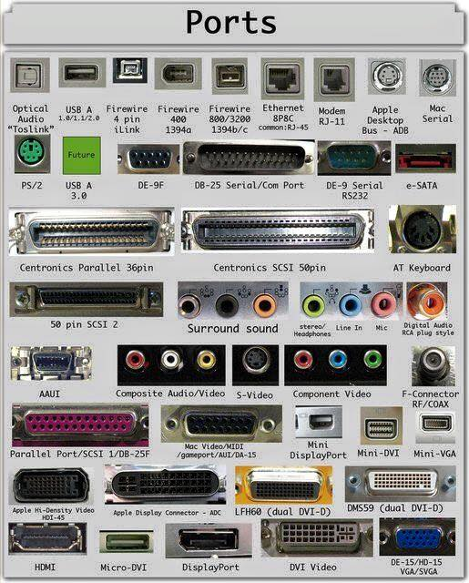
Communication ports
Communication Ports is a hardware device used for connecting peripherals devices with the computer
Some of the Communication Ports are:
Serial Port
Parallel Port
VGA Port
HDMI
USB

Slide 13
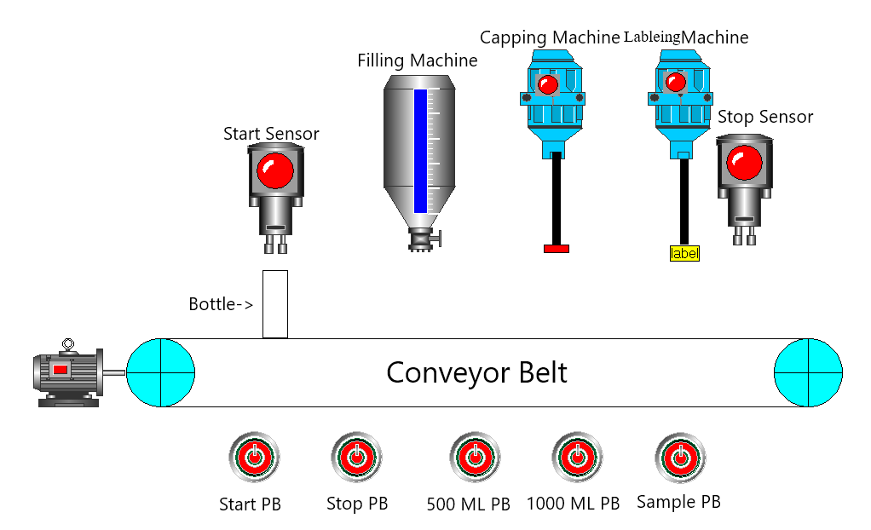
Mini-Project Carried Out At Internship
“Bottle Filling For Different Measurements using PLC and SCADA”
Project Objective:
To design a system using Programmable Logic Controller and SCADA Window with the speciﬁcations given:
There are five Push Buttons Start PB , Stop PB,500 ML PB,1000 ML PB, Sample PB.
One Motor is connected to Conveyor.
Five Sensors are Start, Stop, Filling, capping and Labeling sensor

Slide 14
Abstract
The Abstract of our project is to design, develop and monitor “An Bottle filling system For Different Measurements using PLC”. This work provides with a lot of benefits like low power consumption, low operational cost, less maintenance, accuracy and many more. This project is based on Industrial automation and is a vast application used in many industries like milk industries, chemical, food, mineral water and many industrial manufacturers. A prototype has been developed to illustrate the project.
Introduction
Filling is defined as the method in which liquid is packed into the bottle such as water and other beverages. It can be automated by using Programmable Logic Controller (PLC). In the modern world, Programmable Logic Controller (PLC) is used for this purpose.
The process is controlled by ladder logic. Filling is controlled by using various methods using motor, Filling sensor, Capping sensor, Labeling sensor, conveyor belt and PLC. This process involves placing bottle on the conveyor and filling the bottle at a time. The purpose of this project is to explain the process of filling bottles at a time.

Slide 15
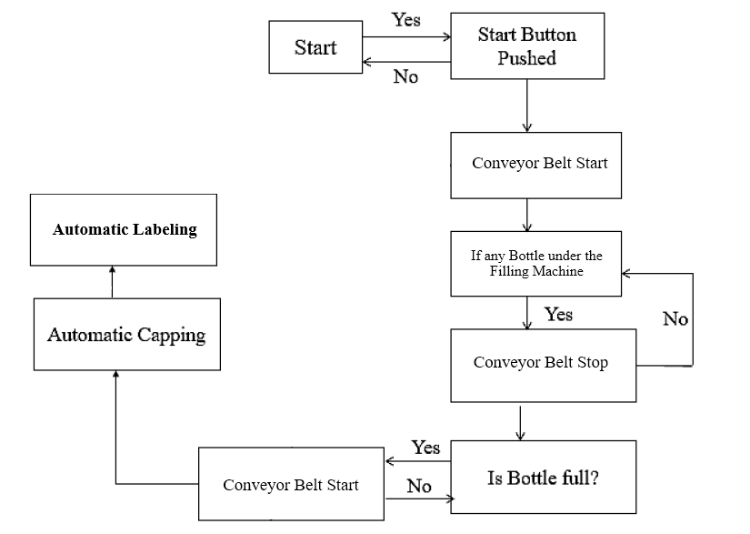
Working Principle

Slide 16
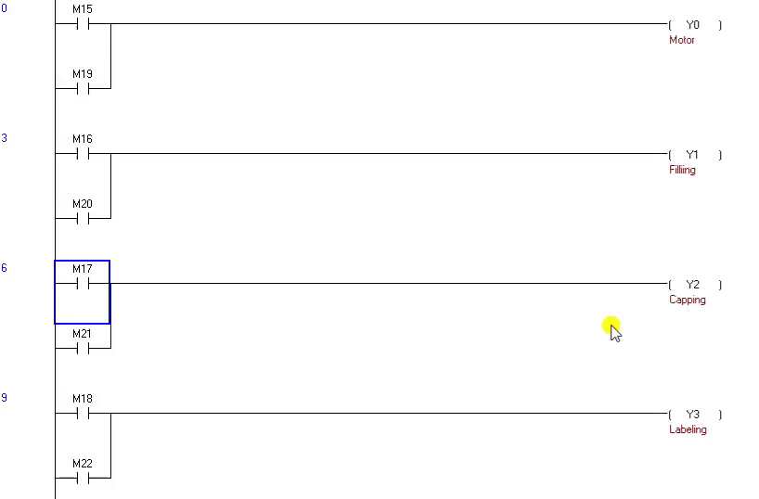
Ladder Logic of Mini-Project.

Slide 17
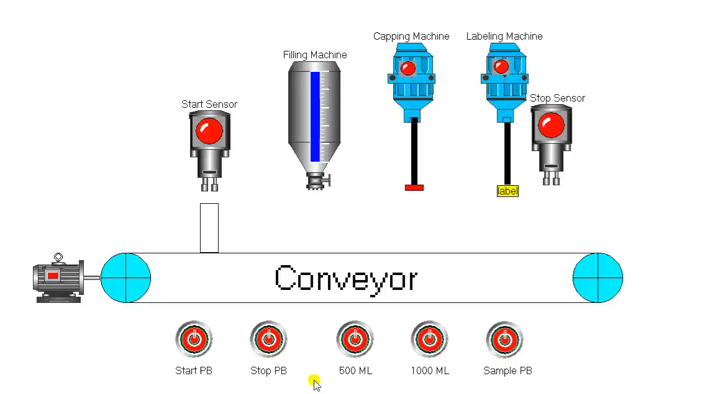
SCADA Implementation of Mini-Project.

Slide 18
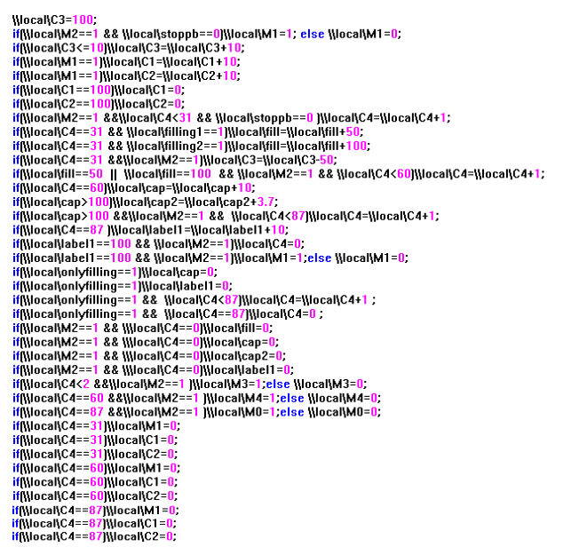
Script Written for SCADA Implementation

Slide 19
Conclusion
“An Bottle filling system For Different Measurements using PLC” has been developed and implemented. The PLC is used in this system to get more productivity with less time high reliability for and flexible in work.
The system is designed to working with different sized bottles by simply change the program.
The ladder diagram language is used in this Project because this language is very useful and has a lot of functions so that most of the industrial application uses this language.
SCADA is used to visualize the working of the Project. The system has the advantages as simple structure and reliable operation. The system is controlled by PLC

Slide 20
References
https://technoclog.com/
https://en.wikipedia.org/wiki/Programmable_logic_controller
https://en.wikipedia.org/wiki/Automation

Slide 21
THANK YOU

